Slide 1

Chapter 14 The Valuation Challenge in Entrepreneurship

Slide 2
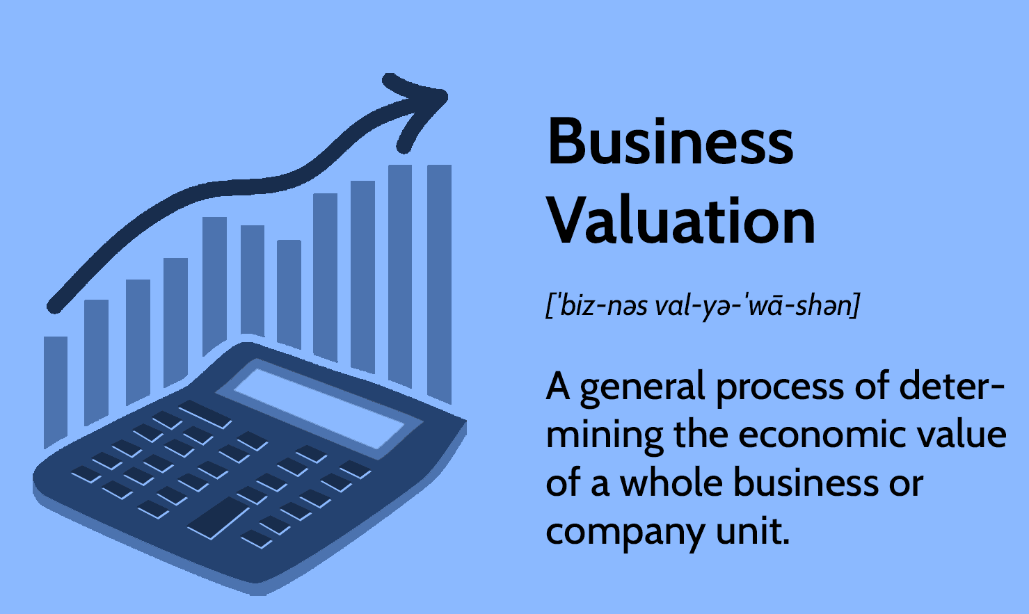

Slide 3
WHY? business valuation
Buying or selling a business, divisions, or major assets.
Establishing an employee stock option plan or profit-sharing plan for employees.
Raising growth capital through stock warrants or convertible loans.
Giving a gift of stock to family members.
Structuring a buy / sell agreement with stockholders.
Attempting to buy out a partner.
Going public with the company or privately placing the stock.

Slide 4
Reasons for the Acquisition
Developing more growth phase products by acquiring a firm that has developed new products.
Increasing the number of customers by acquiring a firm whose current customers will broaden sustainability.
Increasing market share by acquiring a firm in the company’s industry.
Improving or changing distribution channels by acquiring a firm with recognized superiority in the company’s current distribution channel.
Expanding the product line by acquiring a firm whose products complement and complete the company’s product line.

Slide 5
Analyzing The Business (many closely held ventures have the following shortcomings)
Lack of management depth.
Undercapitalization.
Insufficient controls.
Divergent goals (entrepreneur’s vision differs from the investor’s)

Slide 6
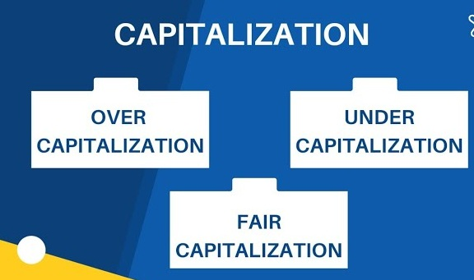

Slide 7
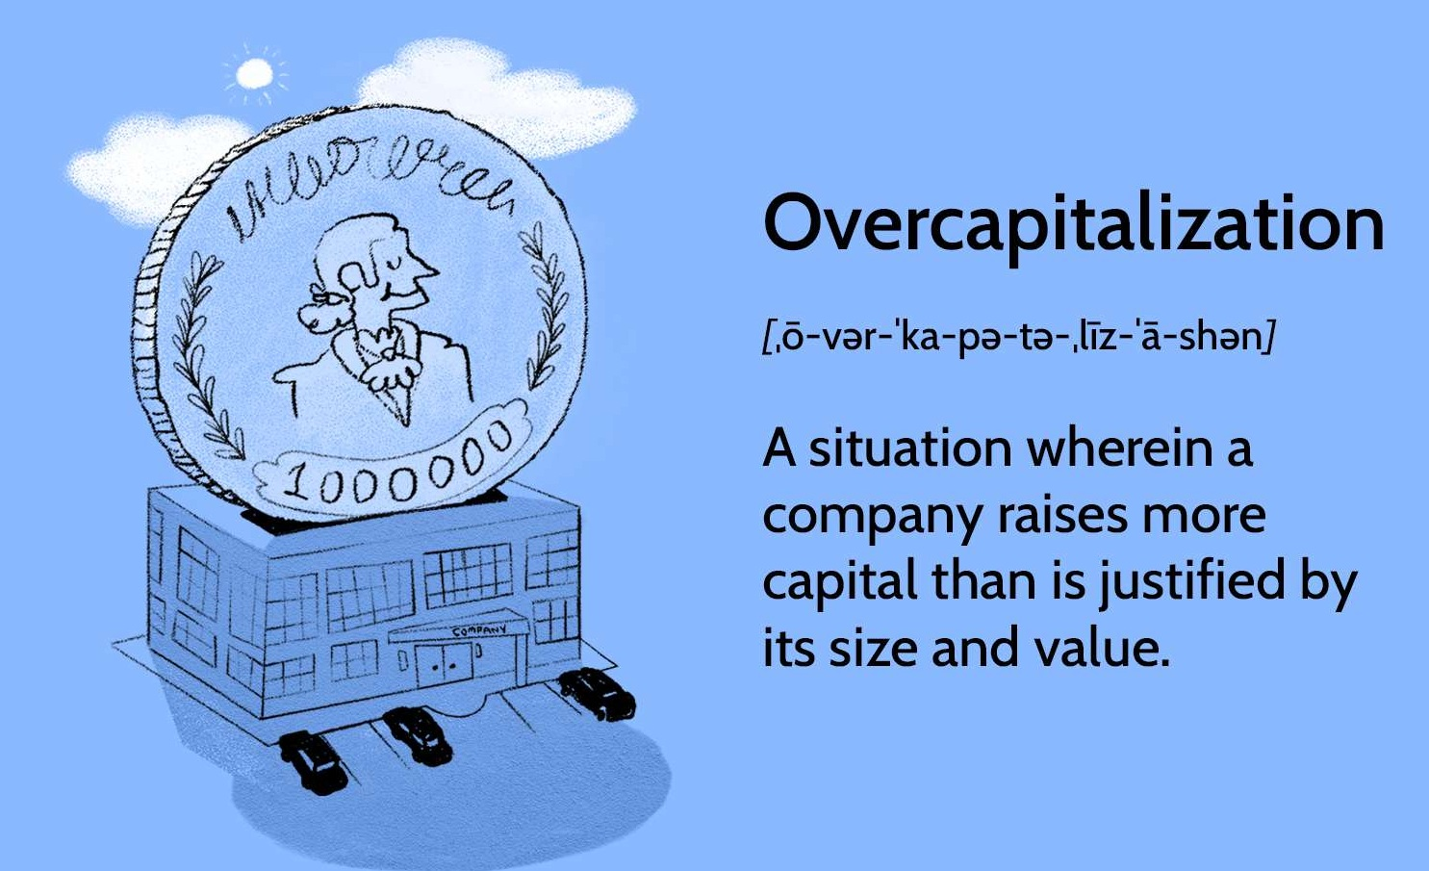

Slide 8
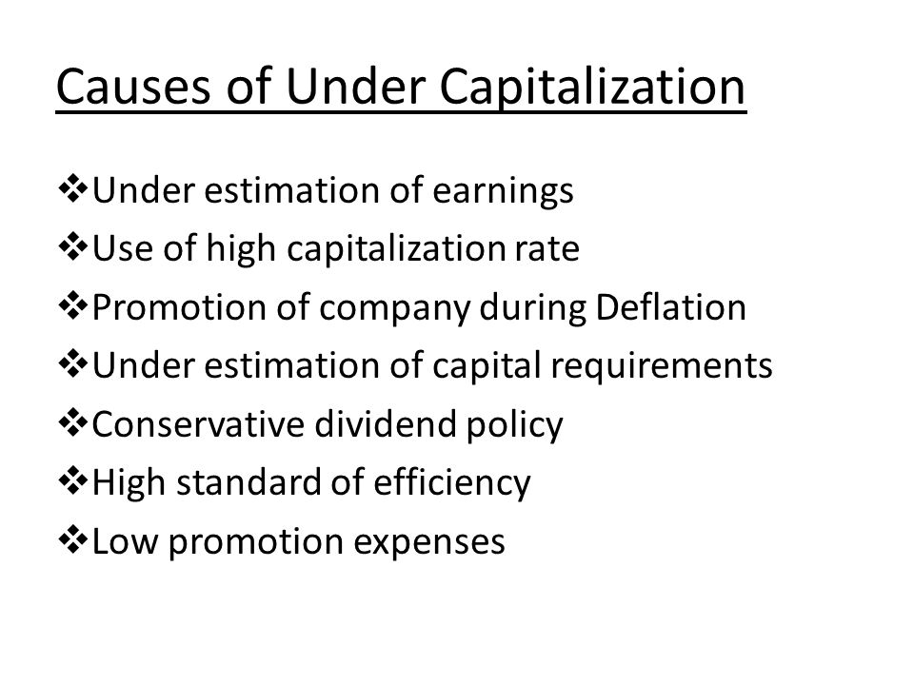

Slide 9
Methods for Venture Valuation
Fixed price (two or more owners set initial value)
Book value (known as balance sheet method)
Set by the business’s balance sheet reflects net worth of the firm total assets less total liabilities.
Price / earnings ratio.

Slide 10
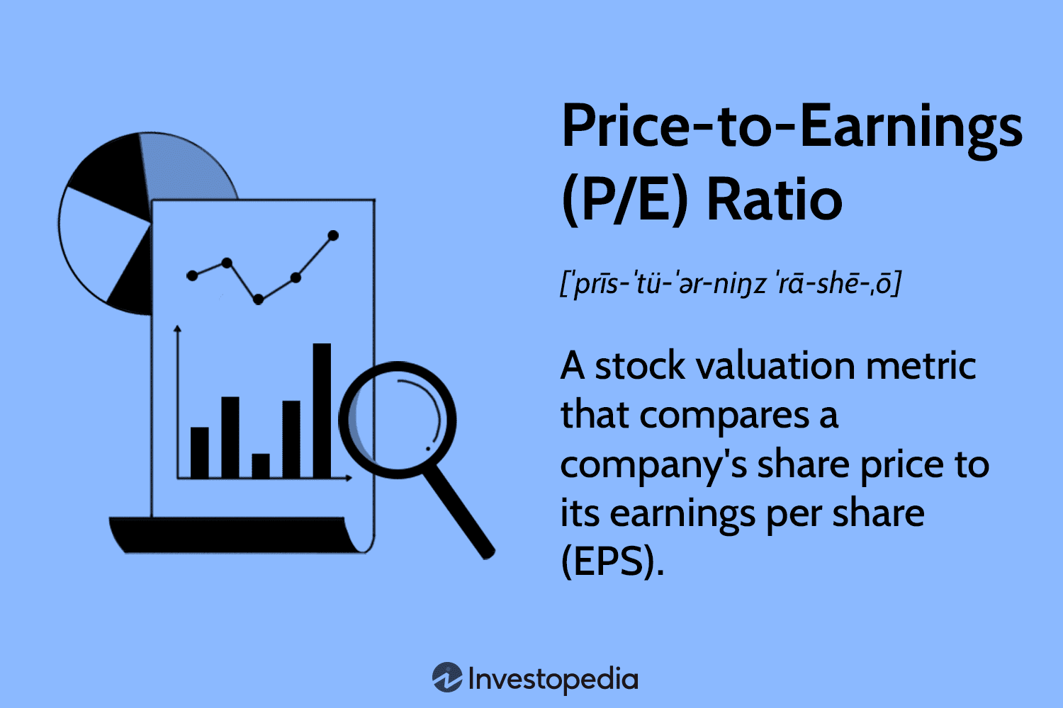
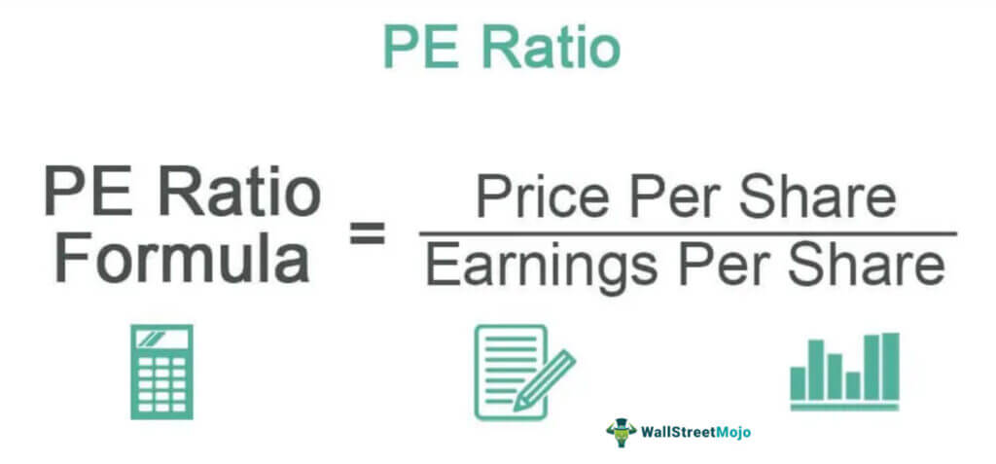

Slide 11
Methods for Venture Valuation
Fixed price (two or more owners set initial value)
Book value (known as balance sheet method)
Set by the business’s balance sheet reflects net worth of the firm total assets less total liabilities.
Price / earnings ratio.
Discounted future earnings.

Slide 12
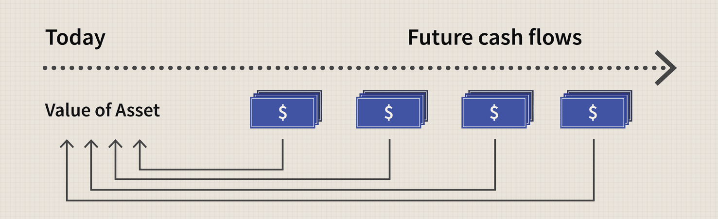
Discounted future earnings

Slide 13
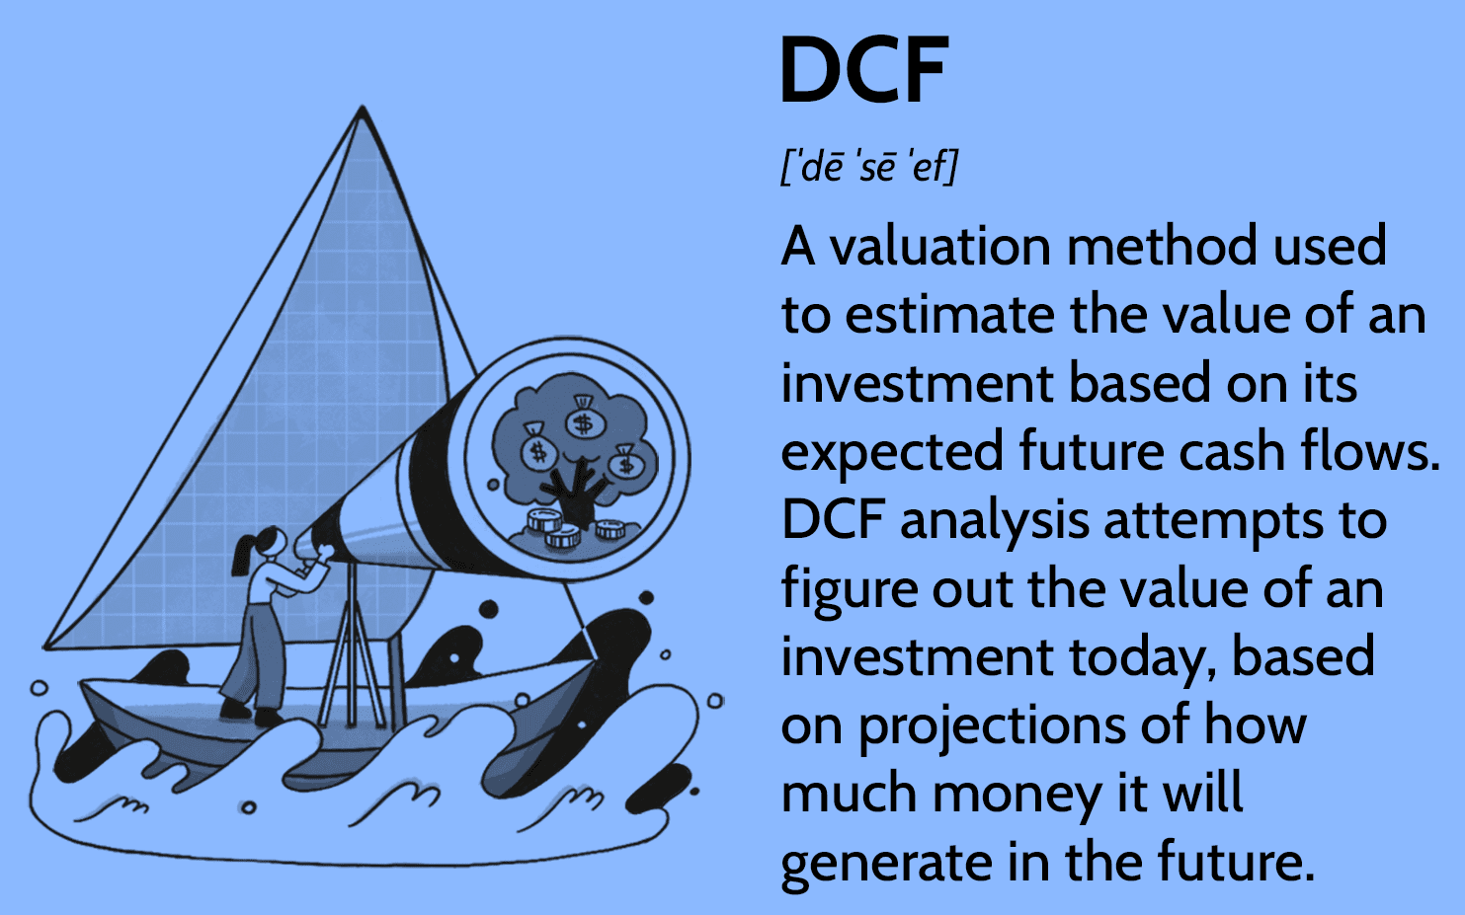

Slide 14
Methods for Venture Valuation
Fixed price (two or more owners set initial value)
Book value (known as balance sheet method)
Set by the business’s balance sheet reflects net worth of the firm total assets less total liabilities.
Price / earnings ratio.
Discounted future earnings.
Return on investment (ROI)

Slide 15
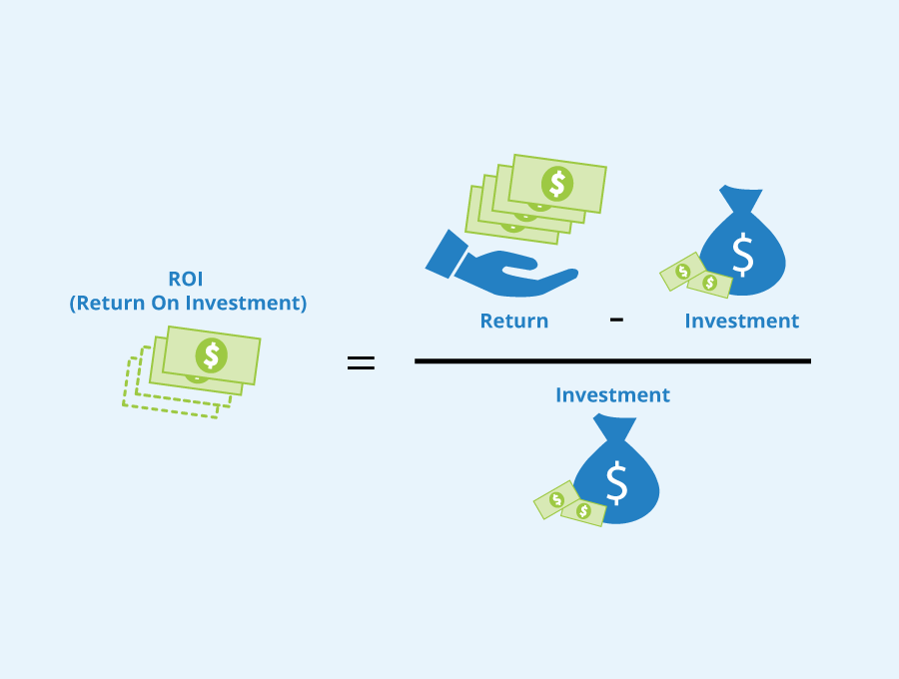

Slide 16
Methods for Venture Valuation
Fixed price (two or more owners set initial value)
Book value (known as balance sheet method)
Set by the business’s balance sheet reflects net worth of the firm total assets less total liabilities.
Price / earnings ratio.
Discounted future earnings.
Return on investment (ROI)
Liquidation value

Slide 17
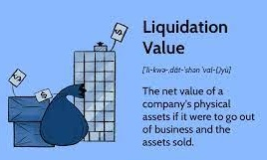

Slide 18
Methods for Venture Valuation
Fixed price (two or more owners set initial value)
Book value (known as balance sheet method)
Set by the business’s balance sheet reflects net worth of the firm total assets less total liabilities.
Price / earnings ratio.
Discounted future earnings.
Return on investment (ROI)
Liquidation value
Market value

Slide 19
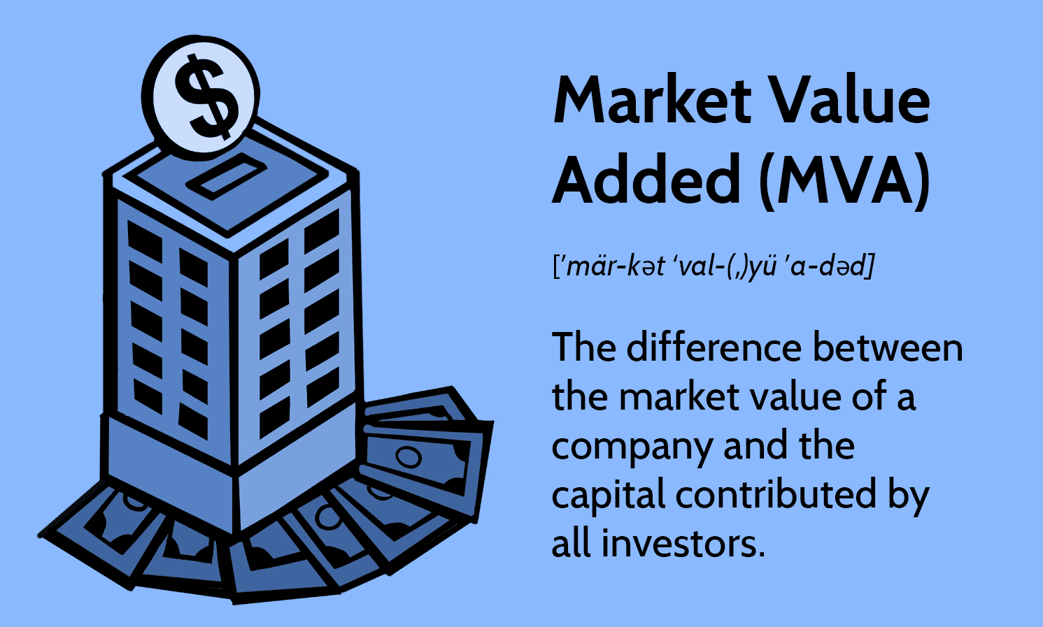

Slide 20
What is this venture worth?
Present the net cash flow projections for this business for next five years.
Use a present value rate of 24 percent.

Slide 21
Additional factors in the valuation process (next three factors that may influence the final valuation of the venture)
Avoiding start-up costs
Accuracy of projections
Always projected on the basis of historical financial and economic data.
Control factor.
The degree of control, an owner legally has.
If 100% control then more value of the firm.
If 50% control then value is according to that share.

Slide 22


